Slide 1
ELEC3844 / MEDE2810 Engineering Management and Society
Dr. Wilton Fok
CYC Room 703
wtfok@eee.hku.hk
Tel: 2857 8490

Slide 2
General information
Lecturers:
PART A: Management and Society
Dr. Wilton .T. Fok
Office: CYC Room 703
whatsapp: +852 93676877 E-mail: wtfok@eee.hku.hk
PART B: Legal
Lecturer: Dr. C.S. Ho

Slide 3
Syllabus:
Professional conduct and social responsibility, e.g. sustainability, technology and environment, ethics at work;
Engineering organization and project, management functions and managerial skills, decision making processes, contingency and crisis management, leadership, corporate culture
Entrepreneurship management skills, how to start a technological social Entrepreneurial startup
Contract, intellectual property, tort, professional negligence and related law issues.

Slide 4

Aim: to equip your skills and knowledge for the preparation of your career path
Managerial
Social
Legal

Slide 5
Management & Social perspective
Management perspective
Decision making tools: SWOT analysis
Risk Management
Crisis Management
Power and Authorities, Empowerment
Organizational Structure
Social perspective
PESTEL Analysis
Engineering Ethics and code of practices(ICAC)

Slide 6
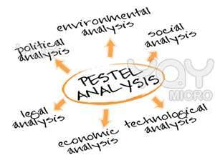
Decision making tools: PESTEL Analysis
Political
Economic
Social
Technical
Environmental
Legal

Slide 7
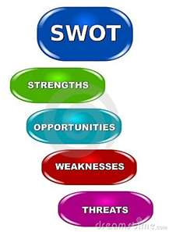
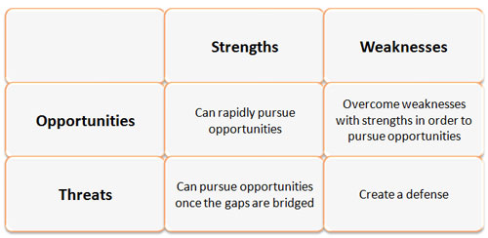
Decision making tools: SWOT analysis
Strengths, Weaknesses,
opportunities and threats

Slide 8
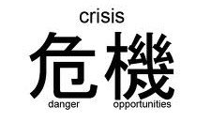
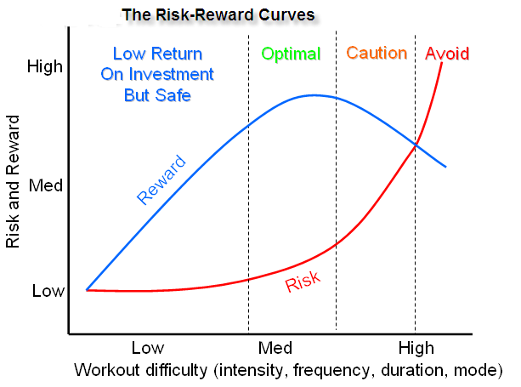
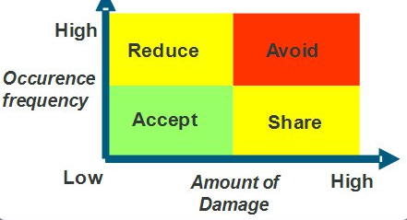
Risk Management, Crisis Management
Risk impact and probability chart
Risk reward curves
Risk and opportunities
Crisis management

Slide 9
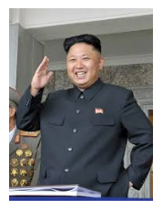

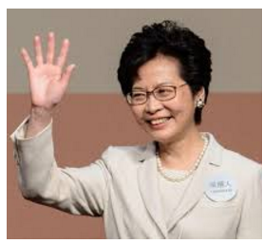


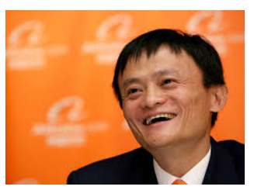
Power and Authorities, Empowerment
Types of power and authorities
Legitimate power, Reward power, Coercive power, Referent power, Expert power
Characteristics of different types of leaders
Types of managers
Ways to empower employees

Slide 10
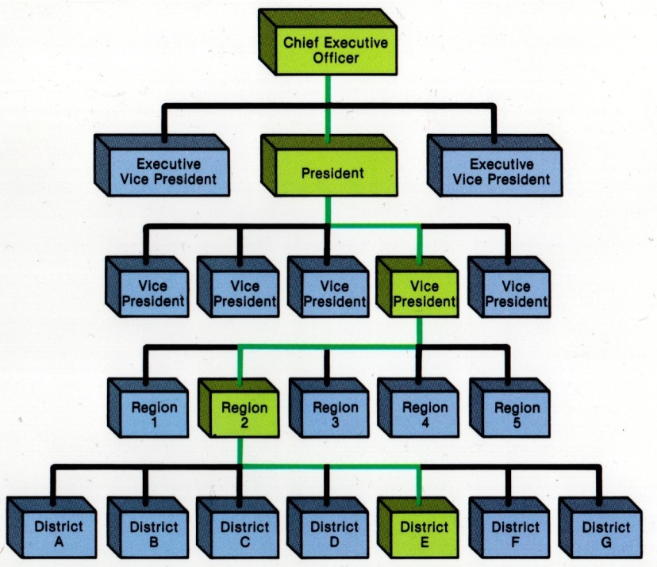
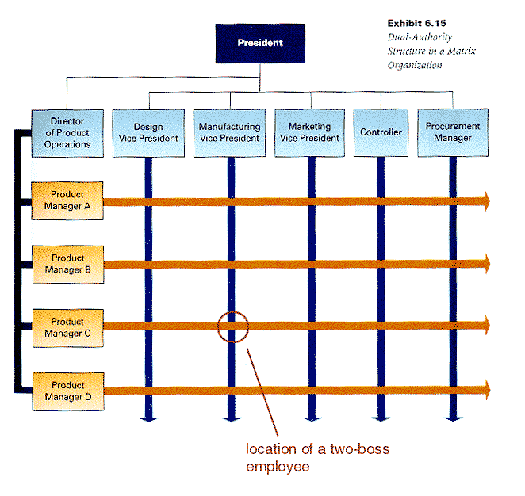
Organization Structure
Types of structures: functional, departmental, divisional, matrix
Pros and cons of different structure
Structure of a successful start-up

Slide 11


Engineering Ethics and code of practices
Corruption in HK, China and other countries
Measures for anti-corruption
Code of practice
Ethics for engineers
Seminar by ICAC

Slide 12
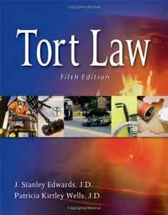

Legal perspective
Introduction of Legal System and Court Structure in HK
Legal Reasoning
Legal Method
Contract Law
Tort Law

Slide 13
Assessment Scheme:
70% examination
In the format of multiple choices, and short questions
Details will be announced shortly
30% In-course assessment
15% Legal by CS Ho
15% PESTEL analysis by Dr. W. Fok

Slide 14
For the 30% assessment – Powerpoint
Form a group of 6 students
Prepare a group presentation on a topic relating to an engineering project or an technology.
Using the PESTEL Analysis as the framework to write the essay
i.e. to cover the Political, Economical, Social, Technological, Environmental and Legal perspectives.
Examples:
Building the bridge, high speed railway, engineering and the climate change, land reclamation, development of nuclear power, genetic engineering…etc.
Submit your ppt with your full name and UID to moodle or before 4 Dec 2021

